Slide 1


Slide 2
Introduction to the team
Made and presented by,
Ronak Ashok Kalantre
Harshal Namdev Kothavade
Hamina Bee Laskar
Soham Vinayak Mali
Nishant Sharad Thanekar
Prathmesh Milind Zinge
Special thanks to Ms Charulata ma’am for her encouraging guidance and the statistics department for their immense support!

Slide 3
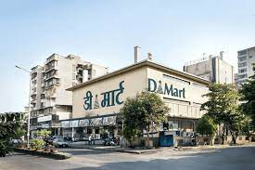
INTRO & ABSTRACT
Shopping has always been an integral part of our lives. From necessities to luxury goods, consumers are constantly looking for products and services that cater to their needs and wants. The choice of a particular brand by the consumer over time is mainly affected by the quality and beneﬁts offered by the brand, especially when it comes to the brand of eatables and cosmetics products. D-Mart's business model is centered around providing its customers with high-quality products at affordable prices. The company operates on a low-cost, high-volume approach, which means that it sells a large number of products at low margins.
D Mart is a retail chain that was founded by Radhakishan Damani in the year 2002. The first D Mart store was opened in Powai, Mumbai, with the aim of offering high-quality products at competitive prices to customers. Over the years, D Mart has grown rapidly and expanded its operations to various cities in India. Today, it has over 200 stores across the country, making it one of the largest retail chains in India.

Slide 4
Methodology
The main aim of this paper is to find the consumer perception regarding D-Mart through a survey.
The objective of the study was to know about the perception, satisfaction level, and attributes of consumers with regard to D-mart products.
Need for this study arises to learn consumer behavior, companies can identify the preferences of their target audience, which will help in designing products and strategies.
For collecting primary data a survey approach was used, we conducted a pilot survey for a sample size of 50. We surveyed a total of 403 individuals through Google Forms. Convenience sampling was used to collect the data.

Slide 5
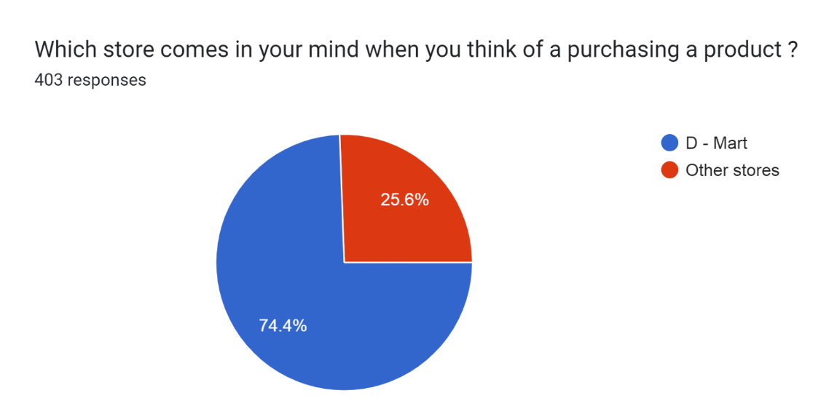
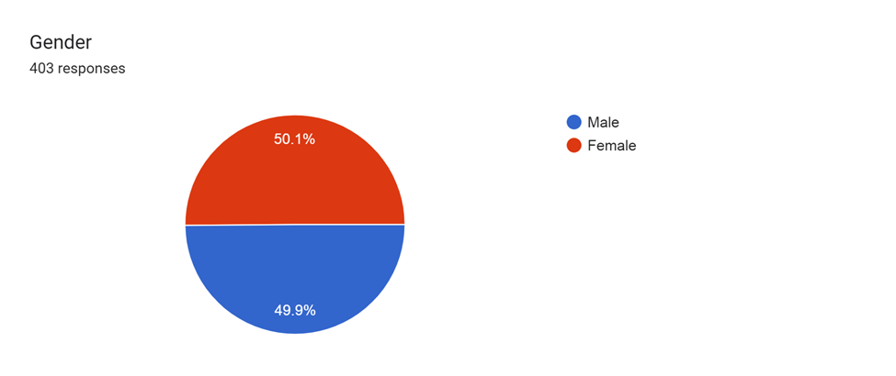
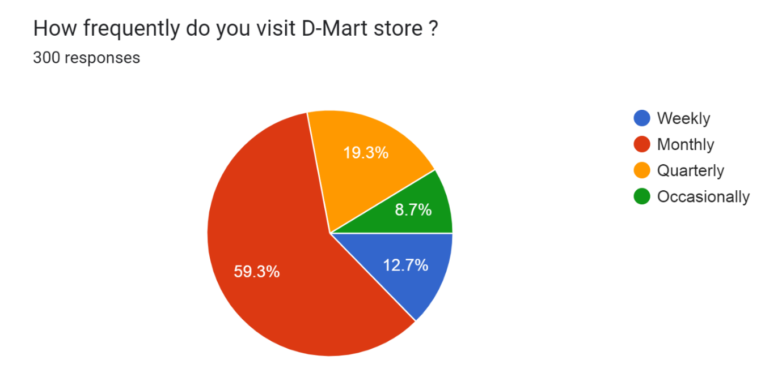
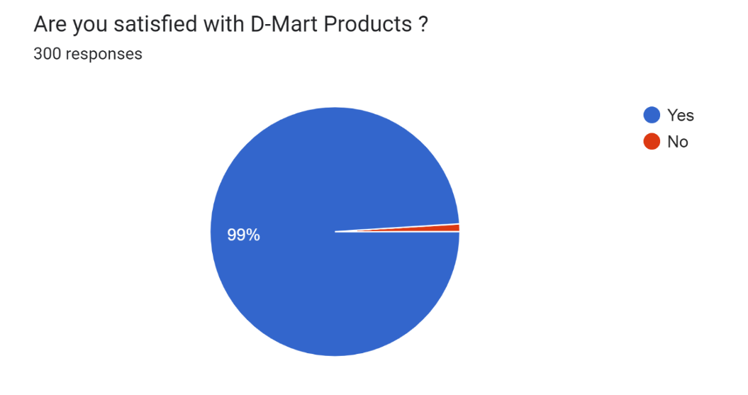

Slide 6
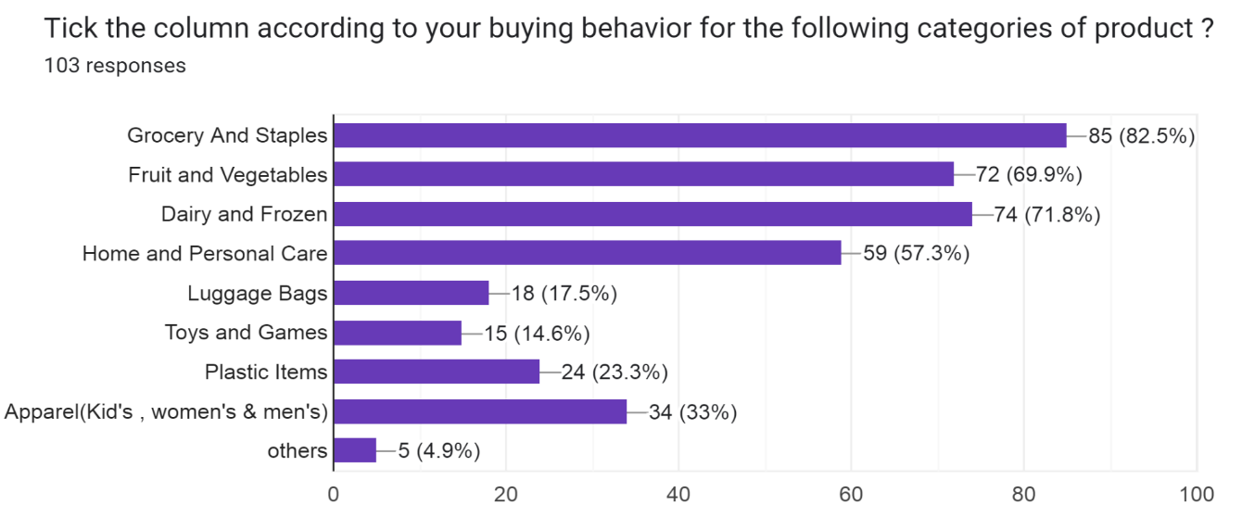
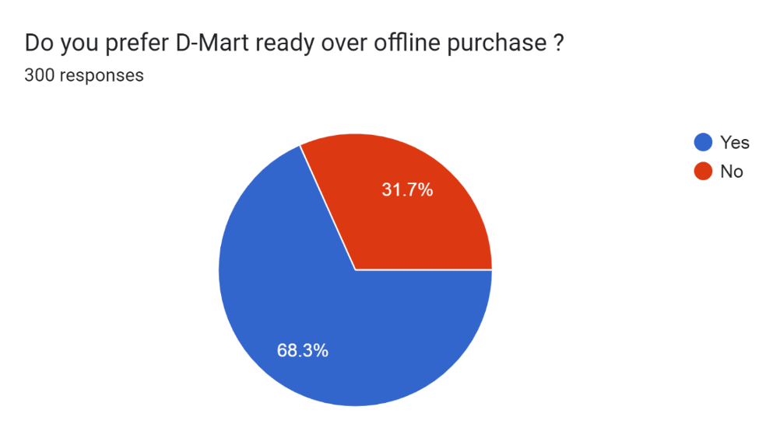
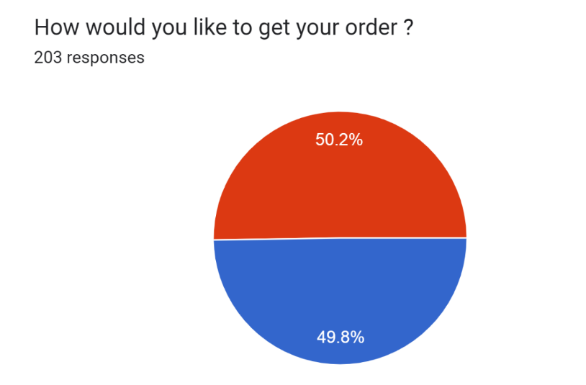
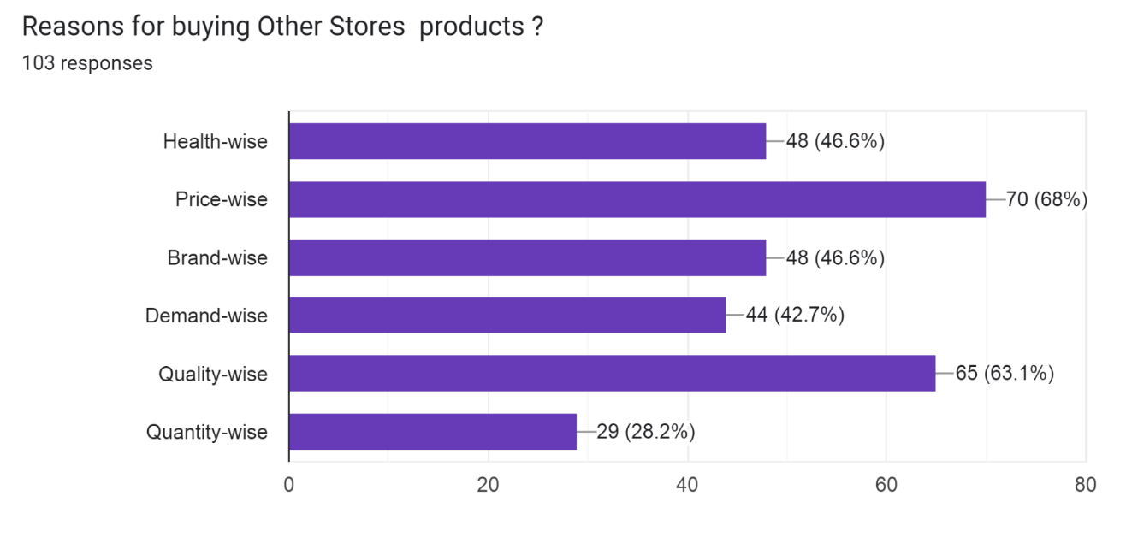
Home delivery. Pick up

Slide 7
People-Centric Management
Discount Policy
Family Experience
Proper distinction based on price
Focus on Certain Places
Rented Assets
Slow Growth
Extended Focus on Low Prices
STRENGTH
SWOT
ANALYSIS
WEAKNESS
OPPORTUNITY
THREAT
Improving Technology
Growth Potential
Developing Economy
Scope for Increasing Market Share
Online competition
Online start-ups
Convenience store
Government policies

Slide 8
CHI-SQUARE TEST OF INDEPENDENCE
Objective
To test the association between occupation and their income for D-mart products.
To test the association between occupation and their the expense for D-mart products.
To test the association between income and their the expense for D-mart products.
Hypothesis
HO1: No significant association exists between the occupation and their income for D-mart products.
H11: Not HO1
HO2: No significant association exists between the occupation and their expense for D-mart products.
H12: Not HO2
HO3: No significant association exists between the income and their expense for D-mart products.
H13: Not HO3

Slide 9
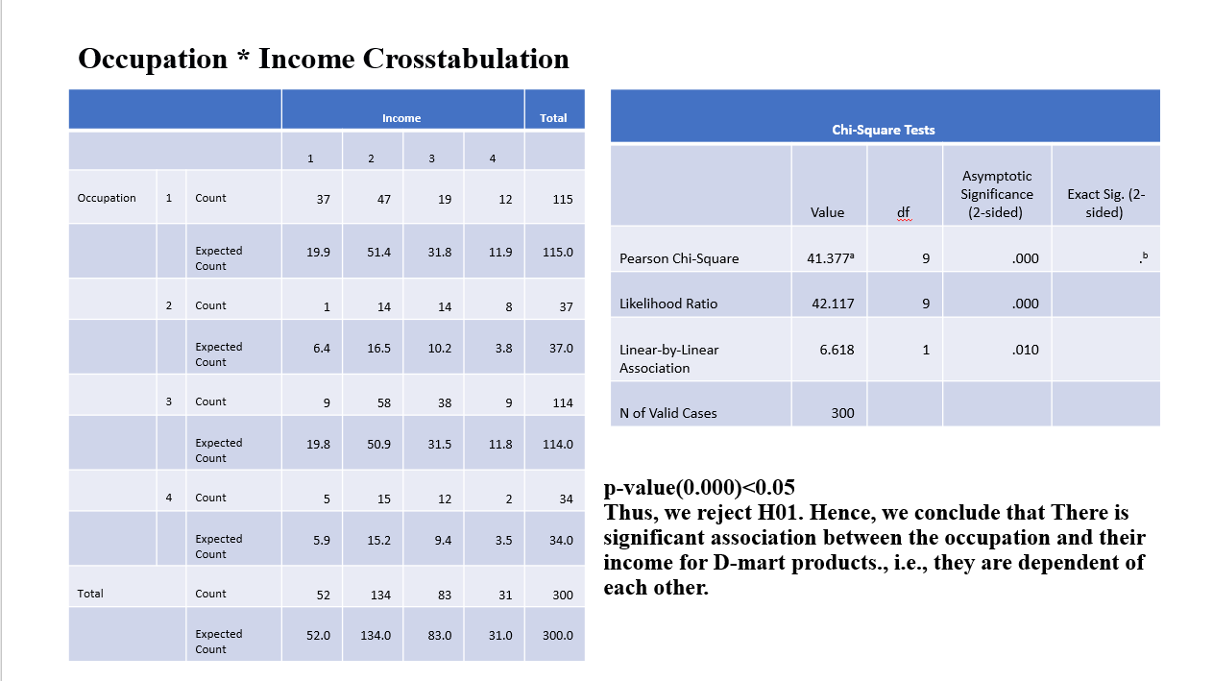
Since p< 0.05 we reject H01. Hence, we conclude that there is a significant association between the occupation and their income for D-mart products., i.e., they are dependent of each other.

Slide 10
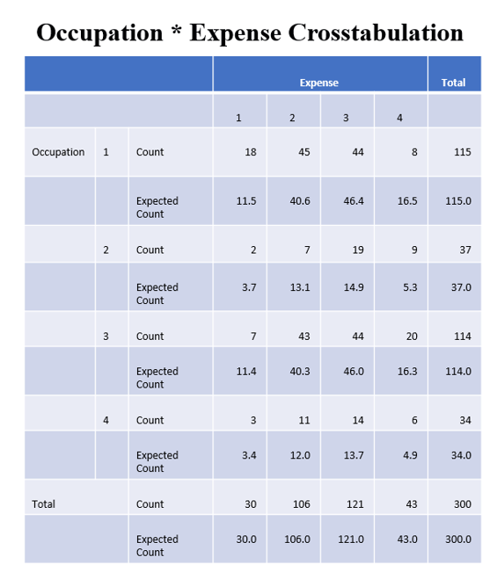
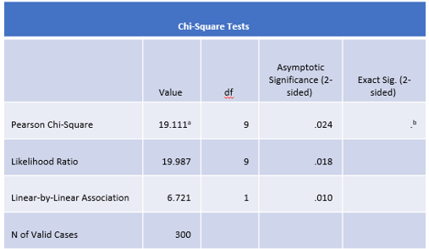
p-value(0.024)<0.05
Thus, we reject H02. Hence, we conclude that There is a significant association between the occupation and their expense for D-mart products., i.e., they are dependent on each other

Slide 11
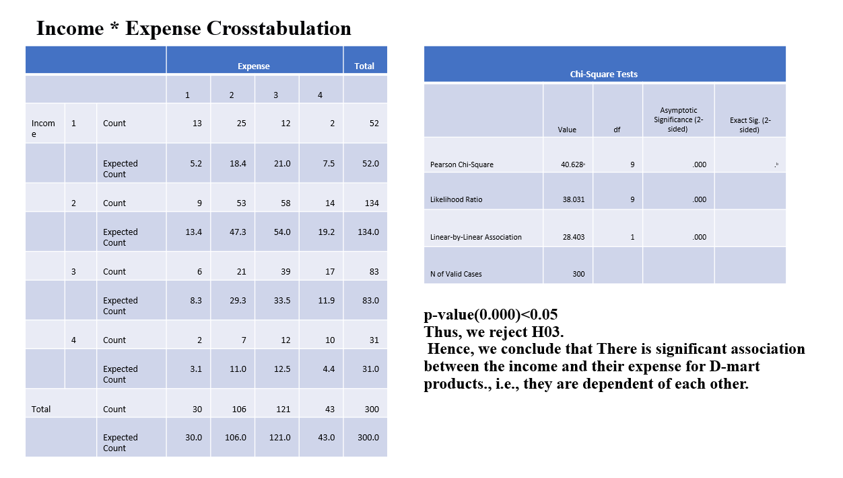
p-value(0.000)<0.05
Thus, we reject H03.
Hence, we conclude that There is a significant association between the income and their expense for D-mart products., i.e., they are dependent on each other.

Slide 12
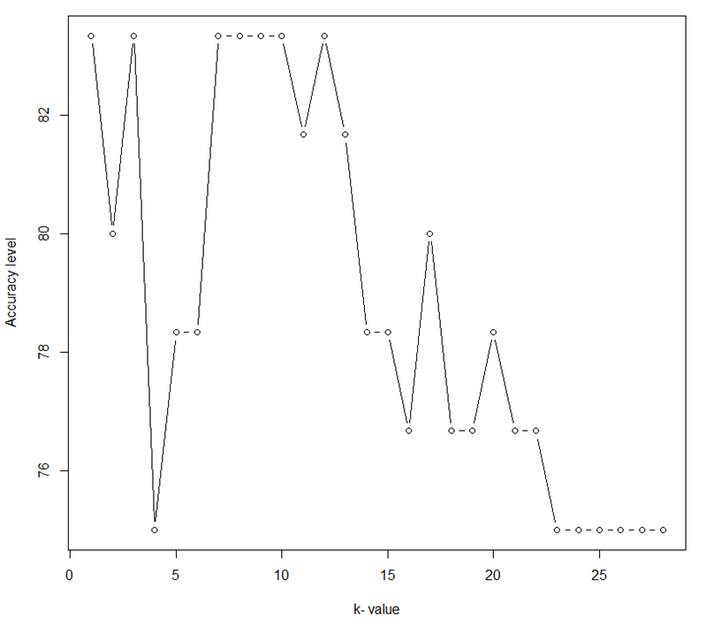
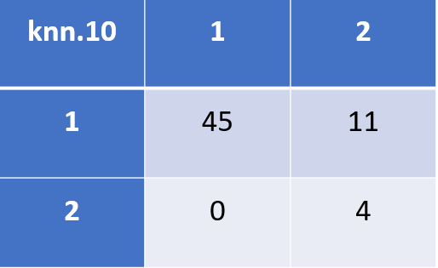
K-NEAREST NEIGHBOR
Objective:
To check whether the customers are satisfied with D-Mart’s offline shopping or not and check the accuracy.
Conclusion:
Out of 56 observations, for 45 observations we are correctly able to predict the offline purchase value as 1, which means that 45 customers are willing to shop offline at D-Mart. Similarly, for 4 observations, we have correctly predicted that the 4 are willing to use online D-Mart shopping.
But for 11 customers we have predicted that they prefer online shopping but due to some reasons are still using offline D-Mart stores.
The accuracy of the Model is 83.33%.

Slide 13
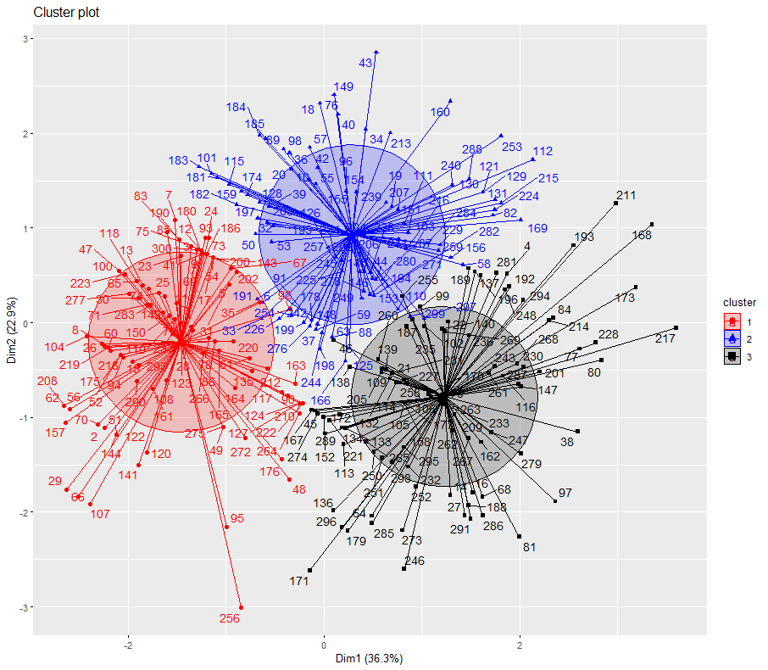
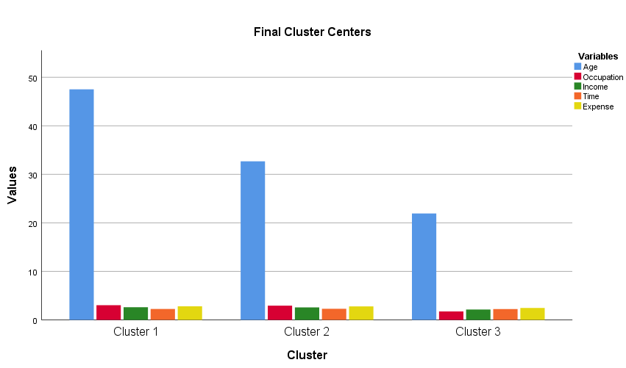
CLUSTERING
Objective:
To group people with similar characteristics

Slide 14
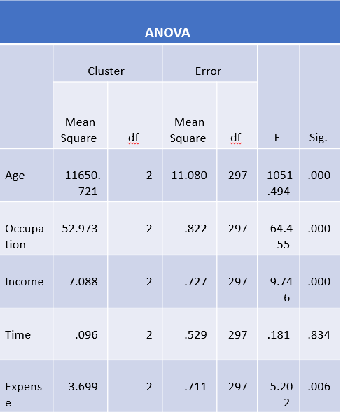
Conclusion:
3 clusters are formed. Age is the most important factor in deciding groups of people.
In cluster 1 on average the income of respondents is 5-9 lakh, age is 48 years, occupation is service and monthly expense is Rs 3000-6000.
In cluster 2 on average the income of respondents is 5-9 lakh, age is 33 years, occupation is service and monthly expense is Rs 3000-6000.
In cluster 3 on average the income of respondents is 1-5 lakh, age is 22 years, occupation is business and monthly expense is Rs 1000-3000.
People working in the service sector most frequently visit D-Mart stores.

Slide 15
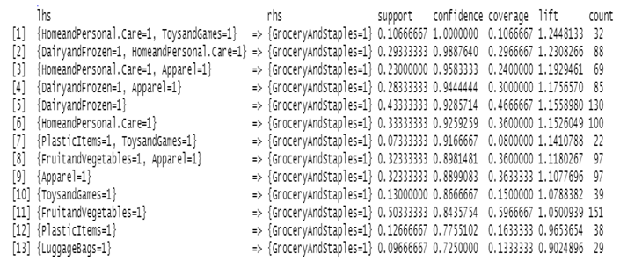
MARKET BASKET ANALYSIS
Objective:
To identify the next product purchase that might interest a customer.
V1 = Grocery and Staples
V2= Fruits and Vegetables
V3= Dairy and Frozen
V4= Home and Personal Care
V5= Luggage Bags
V6= Toys and Containers
V7= Apparel (Kid’s, Men’s & women's)

Slide 16
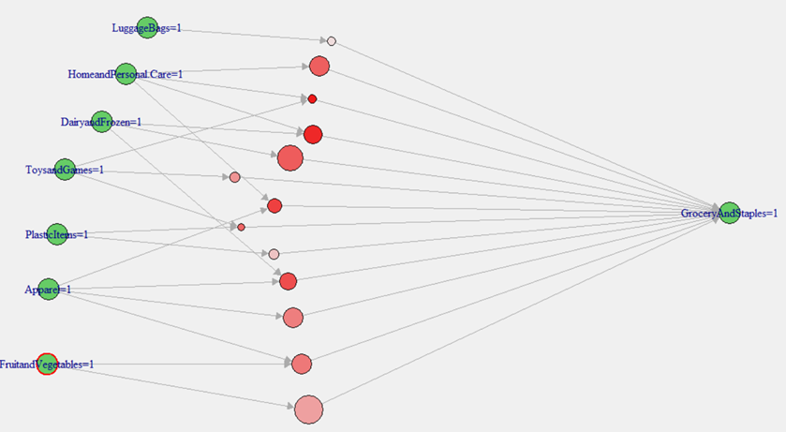
Data Analysis And its Interpretation
Conclusion:
People that are buying Home & personal care, Dairy & Frozen And Dairy & Frozen, and Apparel products are high to buy Staples.

Slide 17
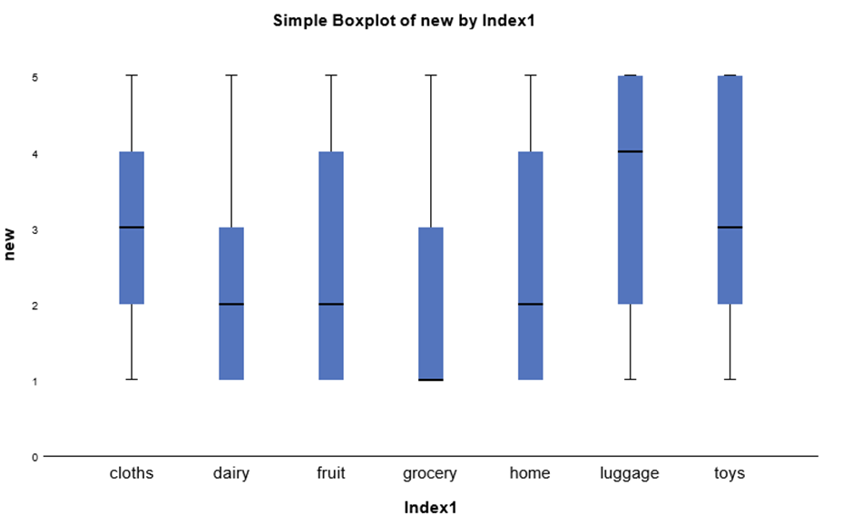
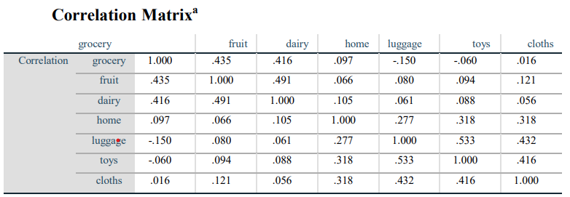
FACTOR ANALYSIS
Objective:
1) To determine the factor that influences people for buying D-Mart products.
V4= Home and Personal Care
V5= Luggage Bags
V6= Toys and Containers
V7= Apparel (Kid’s, Men’s & women's)
V1 = Grocery and Staples
V2= Fruits and Vegetables
V3= Dairy and Frozen

Slide 18
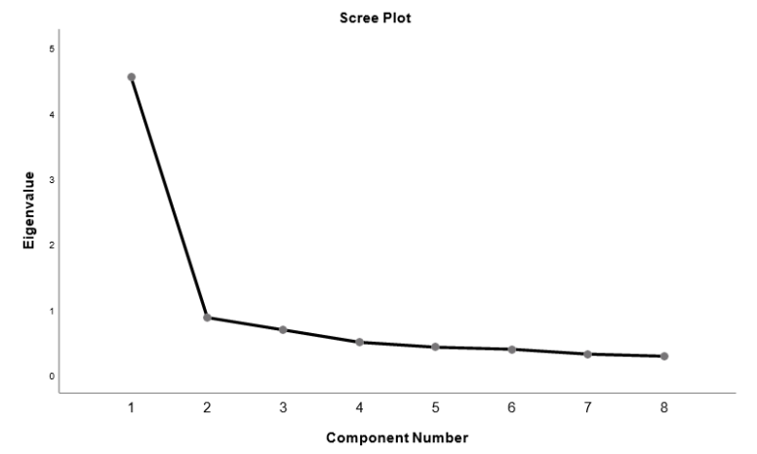
Data Analysis And its Interpretation
Interpretation
KMO Criterion is 0.695. The value of KMO statistics is 0.695 which is greater than 0.5 i.e. sample adequacy is met and we proceed with Factor Analysis as an appropriate technique of data reduction.

Slide 19
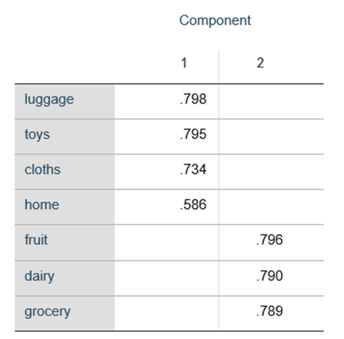
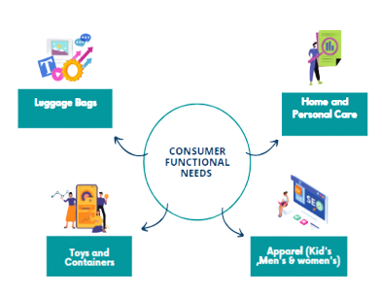
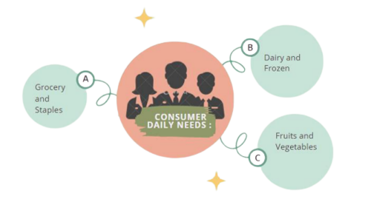
Conclusion
On the basis of factor analysis and graphical representation of the study
Two factors are extracted using those components which are having eigenvalues of more than 1.
The total variance explained by these 2 factors is 58.476%
Here, we get two factors that divide 7 variables.

Slide 20
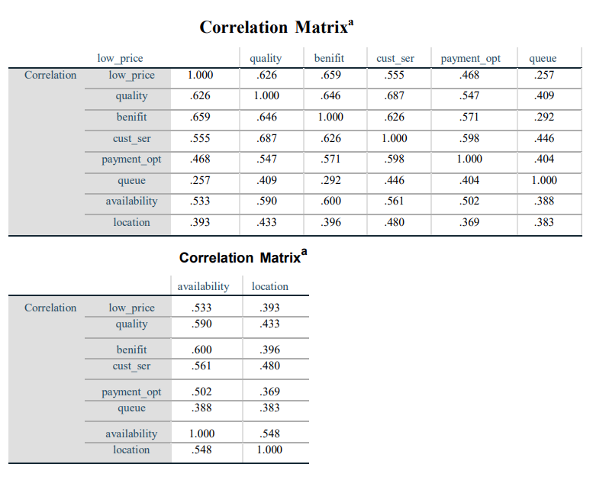
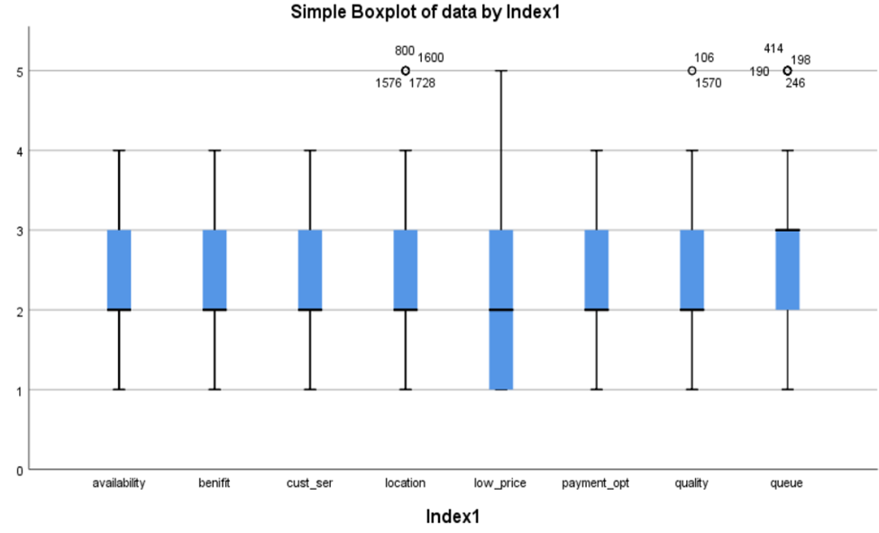
Objective:-
2) To determine the factor that is affecting visiting D-Mart Stores.

Slide 21
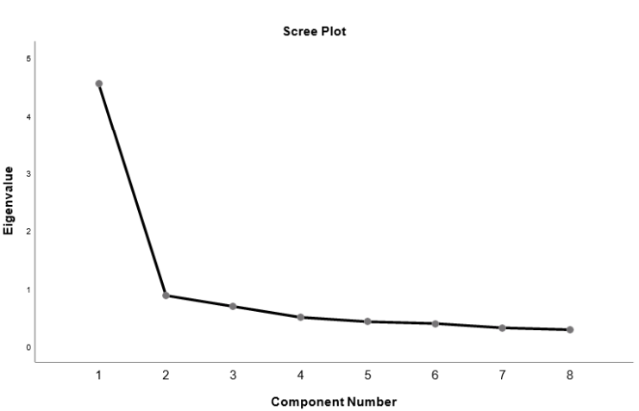
Data Analysis And its Interpretation
Interpretation:
KMO Criterion is 0.907. The value of KMO statistics is 0.907 which is greater than 0.5 i.e. sample adequacy is met and we proceed with Factor Analysis as an appropriate technique of data reduction.

Slide 22
Conclusion:
On the basis of factor analysis and graphical representation of the study. The following are the conclusions:
Two factors are extracted using those components which are having eigenvalues of more than 1.
The total variance explained by these 2 factors is 67.734%
Here, we get two factors that divide 8 variables.
Customer
benefit
Benefit
Low price
Service
Availa-bility
Payment
option
Quality
Consumer worries
Queue
Location

Slide 23
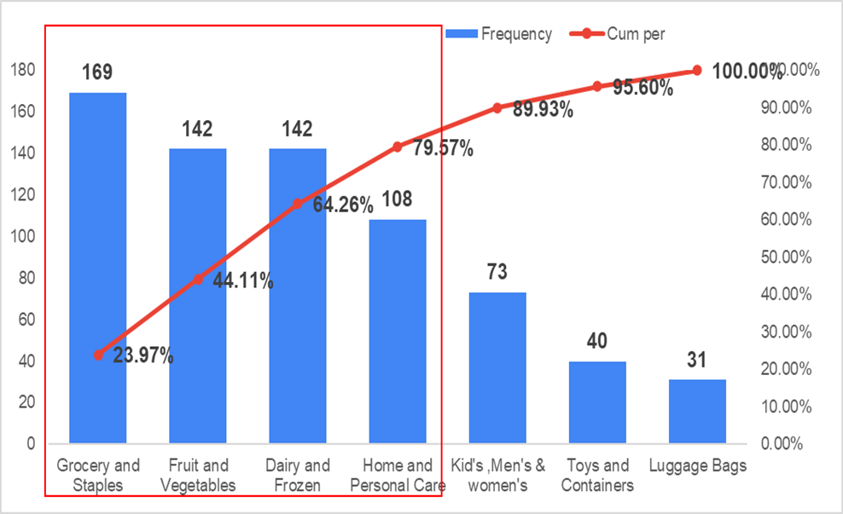
PARETO ANALYSIS
Objective:-
To study the major products that are responsible for increasing sales in D-Mart.
Conclusion:-
Grocery & Staples, Fruit & Vegetables, Dairy & Frozen, and home & personal care are the major factors that influence people to shop at D-Mart

Slide 24
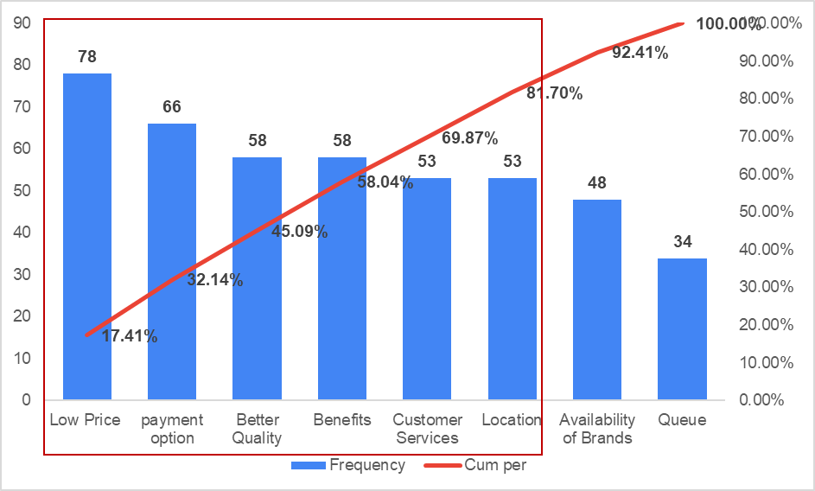
Objective:-
To study the major factors that are responsible for people to visit D-Mart Store.
Conclusion:-
Low Prices, payment options, Better quality, Benefits, customer service, and location are the major factors that influence people to visit D-Mart Stores.

Slide 25
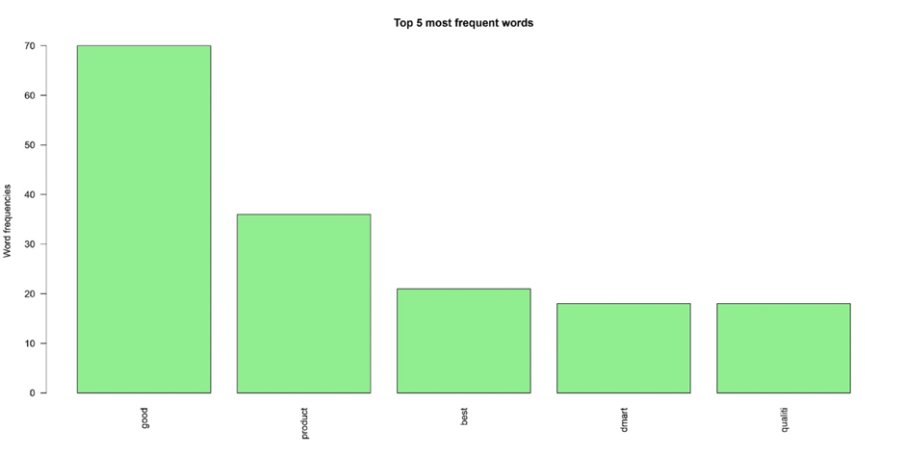
SENTIMENT ANALYSIS
Objective:-
To determine customers’ behavior towards the products of D-Mart.
CASE 1
Interpretation
The most frequently occurring word is “good”. Also, notice that negative no negative word is used in the data.
“Good”, “Product”, “Best”, “D-Mart”, and “Quality” are the most frequently occurring words, which indicate that most people feel good about their work and their health.

Slide 26
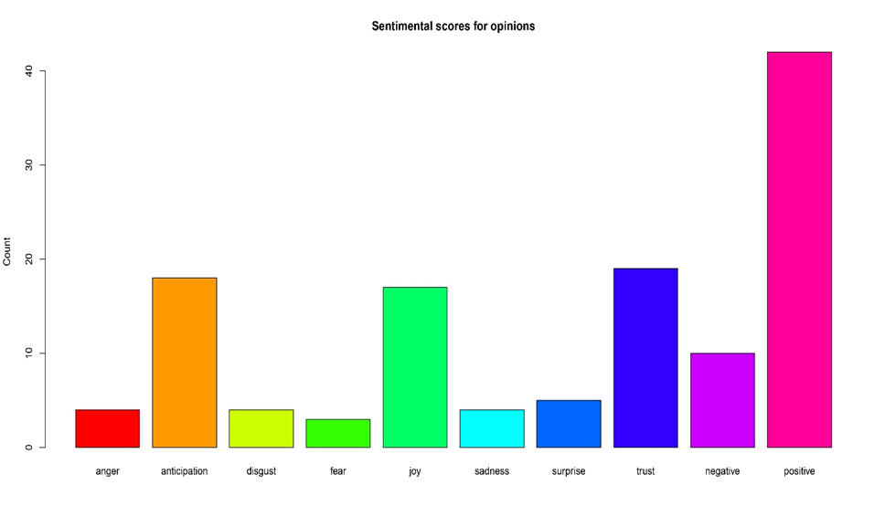
CASE 2
Interpretation
This bar chart demonstrates that words associated with the best emotion of “positive” occurred above forty times in the text, whereas words associated with the worst emotion of “disgust” occurred less than ten times.

Slide 27
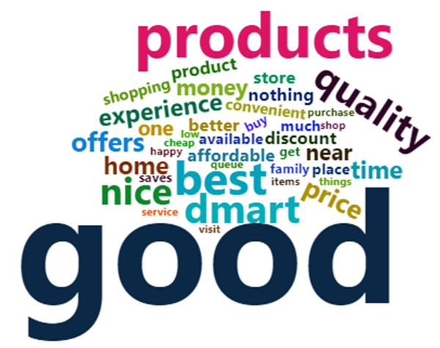
CASE 3
Interpretation
It has been observed that words such as “good”, “Product” and “quality” have been expressed to a greater extent.
Some of the words like “best”, “D-Mart” and “nice” are the above point. Those customers are shopping from D-Mart are satisfied with the D-Mart with all positive feedback.

Slide 28
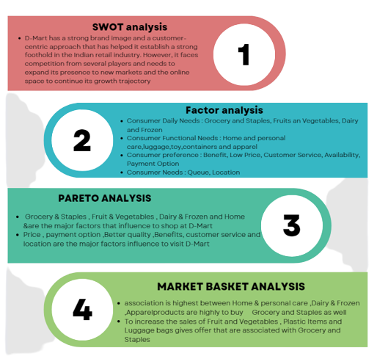
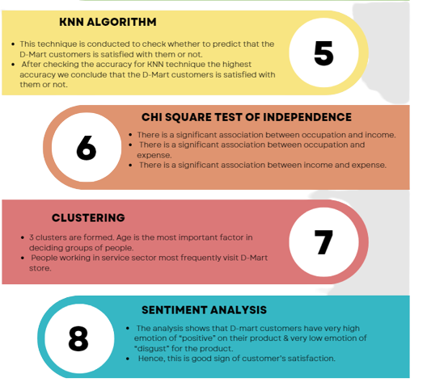
CONCLUSIONS

Slide 29
THANK YOU!

